Slide 1
Accommodation Crawler
Predicting sale and rental prices
Eddy Martínez

Slide 2

Obtaining data
Property URLs storing (AWS RDS)
f"/{option}/property/{region}/?page_size=50&search_source=refine&radius=0&view_type=grid&pn={page}"
URL Finder
Property URLs fetching
Property websites query URL forming
Property Scraper
Clean data storage
Raw data storing (AWS RDS)
Data cleaning
URLs
Properties database
Multiprocessing if possible
Property images storing (AWS S3)

Slide 3
Data preprocessing
Drop redundant columns
One Hot encoding
"address","postcode”, "country", "city", "google_maps", "agency", "agency_phone_number", "url", "pictures", "description", "updated_date"
Property_type
Splitting
Train / Validation / Test
Normalizing

Slide 4
GridSearch
Search over different hyperparameters combinations for each model:
Linear Regression: 'fit_intercept': [True, False],
'normalize': [True, False]
KNN Regression: 'n_neighbors': list(range(1, 10)),
'weights': ['uniform', 'distance']

Slide 5
GridSearch
Decision Trees Regression:
'min_samples_split': list(range(2, 10)),
'min_samples_leaf': list(range(1, 10)),
'min_weight_fraction_leaf': [num/100 for num in range(51)]
Random Forest Regressor (not implemented):
'n_estimators': [num*10 for num in range(1, 10)],
'min_samples_split': list(range(2, 10)),
'min_samples_leaf': list(range(1, 10)),
'min_weight_fraction_leaf': [num/100 for num in range(51)]

Slide 6
Results
Best Model: Random Forests
Parameters:
num_of_estimators: 100
min_samples_leaf: 8,
min_samples_split: 5,
min_weight_fraction_leaf: 0.0
Score (R squared):
Training score: 0.51,
Validation score: 0.27,
Test score: 0.52

Slide 7
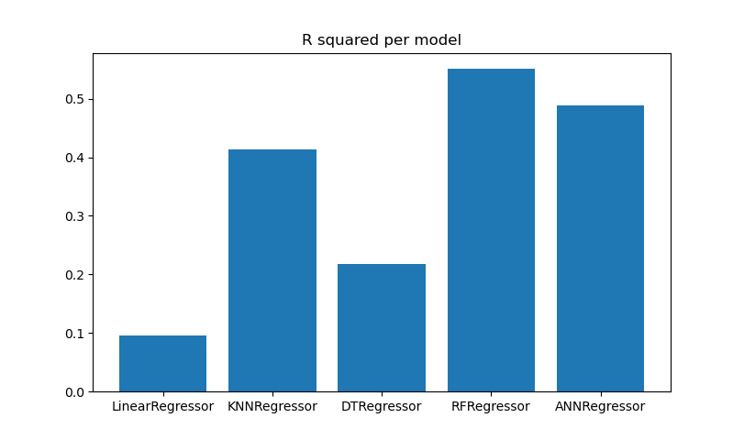
Validation Score

Slide 8
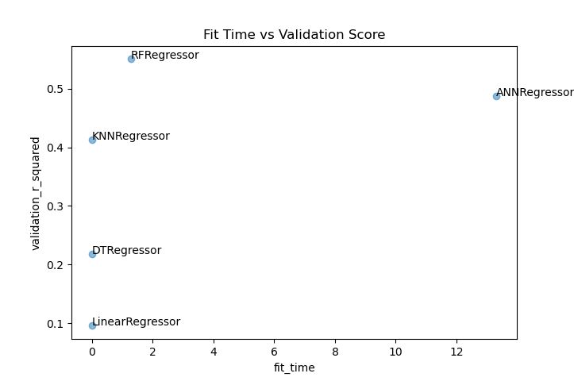
Fit time vs. Validation Score

Slide 9
Future work
Check how representative is this data and get more data
Research if something apart from the selected features influences the results.
Implement front end
Use cloud ML pipeline tools
Implement graphs and dashboards for visualization of model performance.

Slide 10
Questions / Recommendations

